Slide 1
Chapter 7
Introduction to XML
Programming the World Wide Web
Fourth edition
By Robert W. Sebesta

Slide 2
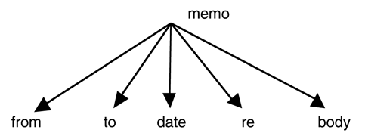
Figure 7.1 An example of the document tree structure for an element definition

Slide 3
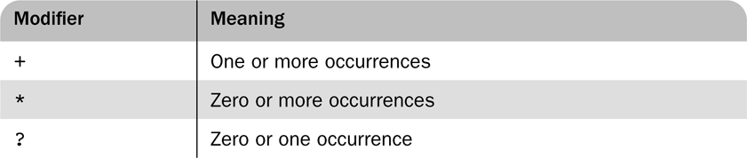
Table 7.1 Child element specification modifiers

Slide 4
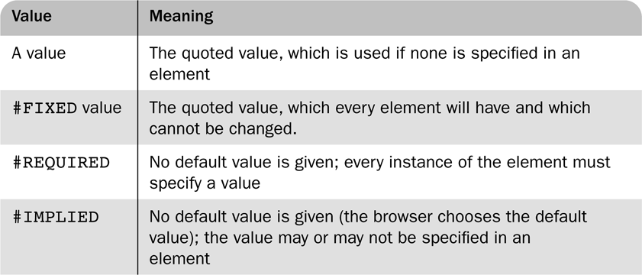
Table 7.2 Possible default values for attributes

Slide 5
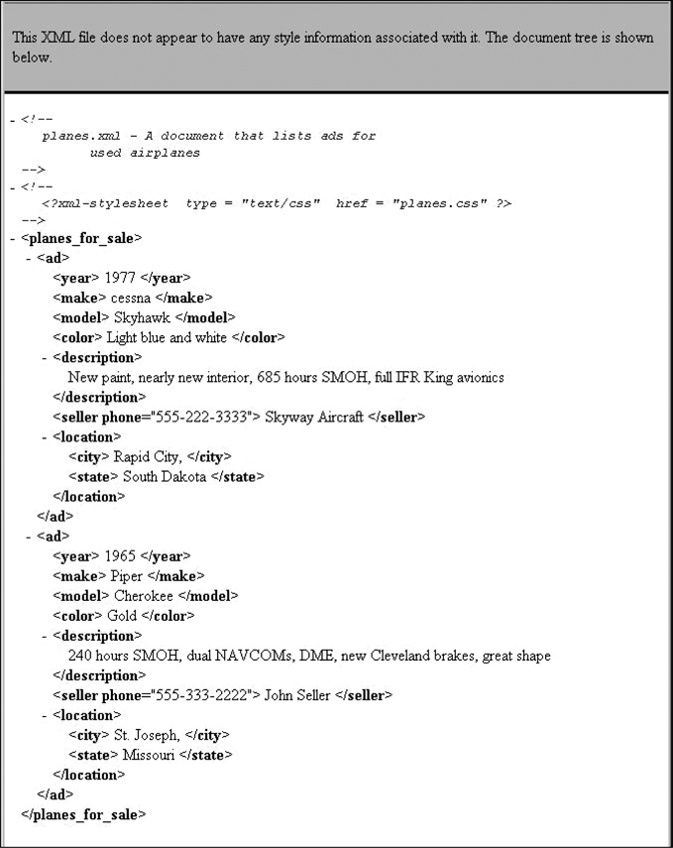
Figure 7.2 A display of an XML document with the FX2 default style sheet

Slide 6
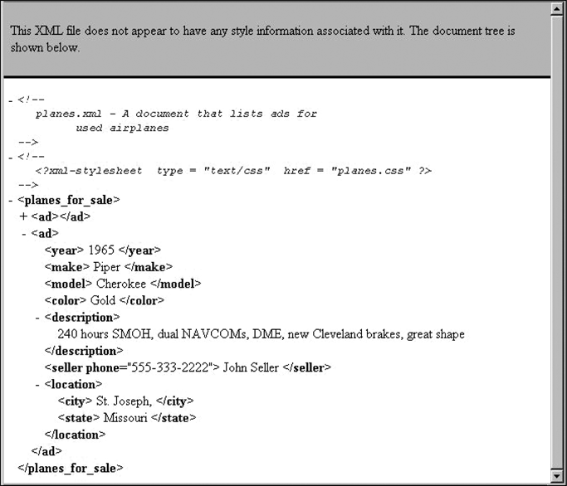
Figure 7.3 The document of Figure 7.2 with the first ad element elided

Slide 7
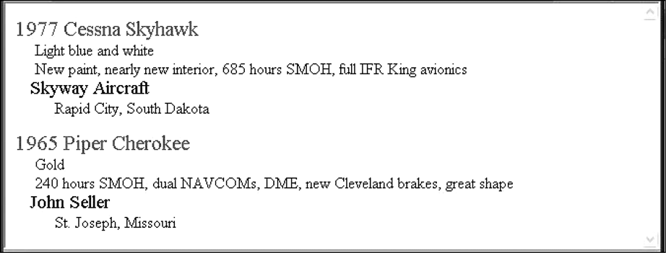
Figure 7.4 The result of using a CSS style sheet to format planes.xml

Slide 8
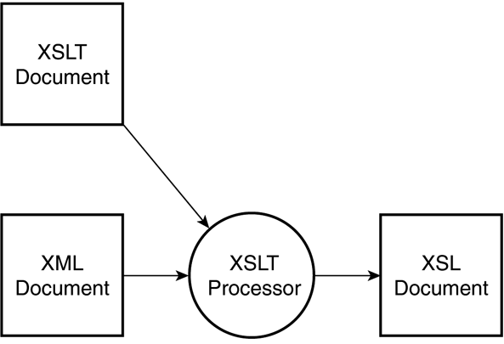
Figure 7.5 XSLT processing

Slide 9
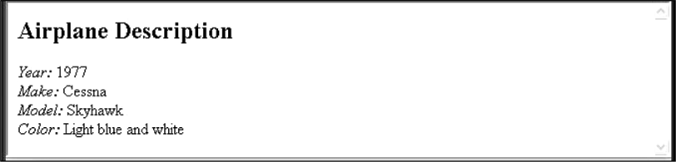
Figure 7.6 An output document from the XSLT processor

Slide 10
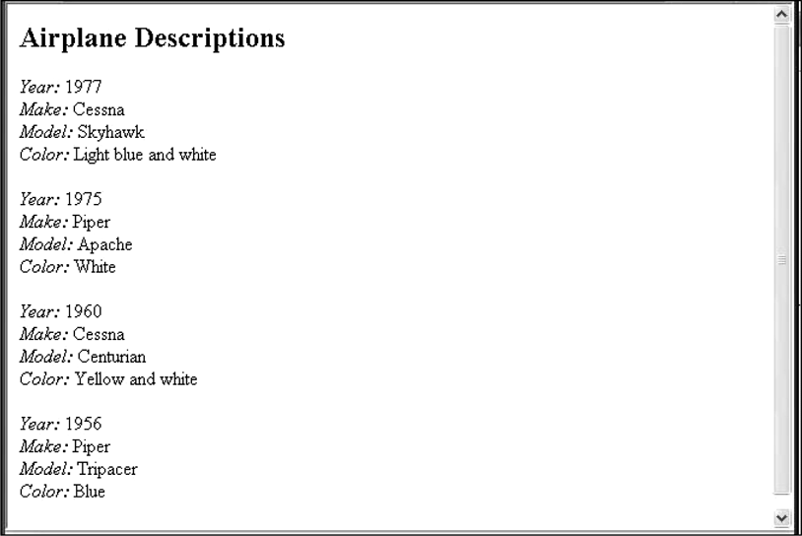
Figure 7.7 Using the for-each element for lists of elements

